Slide 1

Traffic Light Management System
Team #4
Saleem Hamo (2944943H)
Omar Abdelkrim (2931789A)
Alexandru-Mihai Sava (2955854S)
Miguel Rosa (2849121R)

Slide 2

The average person throughout their lifetime spends
FIVE YEARS
waiting in lines and queues
where roughly
SIX MONTHS OF THAT
is waiting for traffic signals to change
How Much Time People Spend Doing Stuff In Their Lifetime
Malta Daily: The average person waits spends six months of lifetime waiting for traffic signals to change

Slide 3
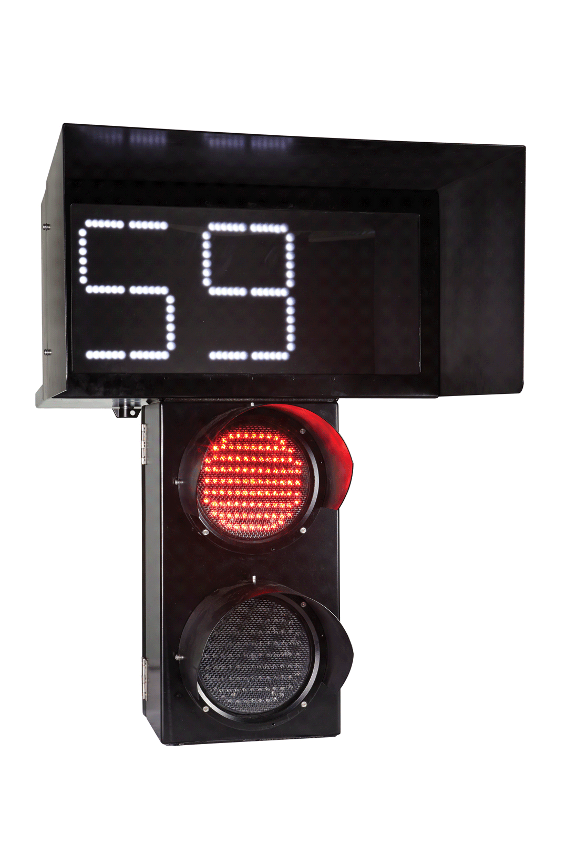
How long does it take lights to change?
Usually fall between 45 and 120 seconds
based on traffic volume and traffic patterns
Glasgow councillor says pedestrian crossing waiting time
‘should only be 30 seconds’
New York City DOT
Glasgow World

Slide 4
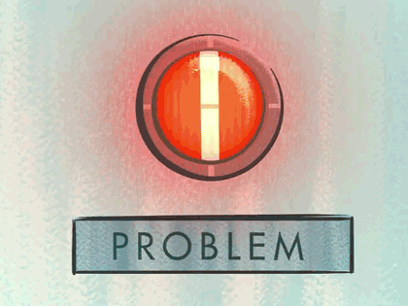
People don’t wait
They just walk…
No matter if it was safe or not

Slide 5

Approximately 1.19 million people die each year because of road traffic crashes
More than half of them are pedestrians
an average of 8 pedestrians died and 115 were seriously injured (adjusted) per week in reported road collisions.
most pedestrian fatalities (56%) do not occur at or within 20m of a junction
Road traffic injuries
Reported road casualties Great Britain: pedestrian factsheet 2021

Slide 6
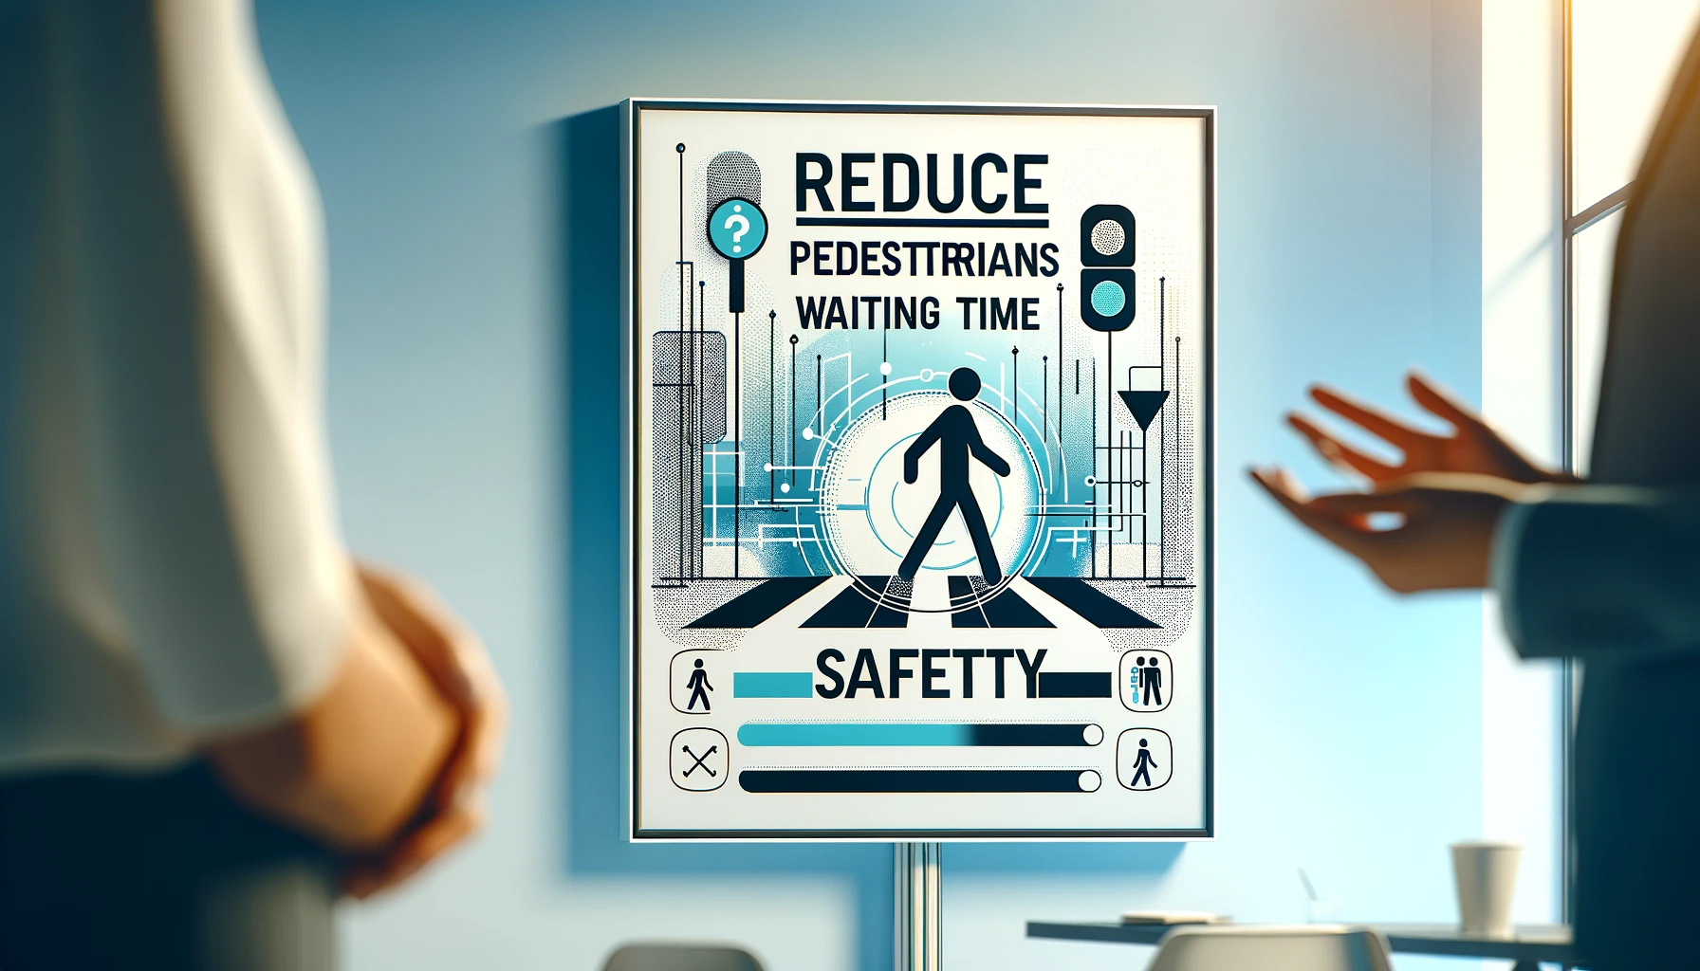
We will focus on

Slide 7
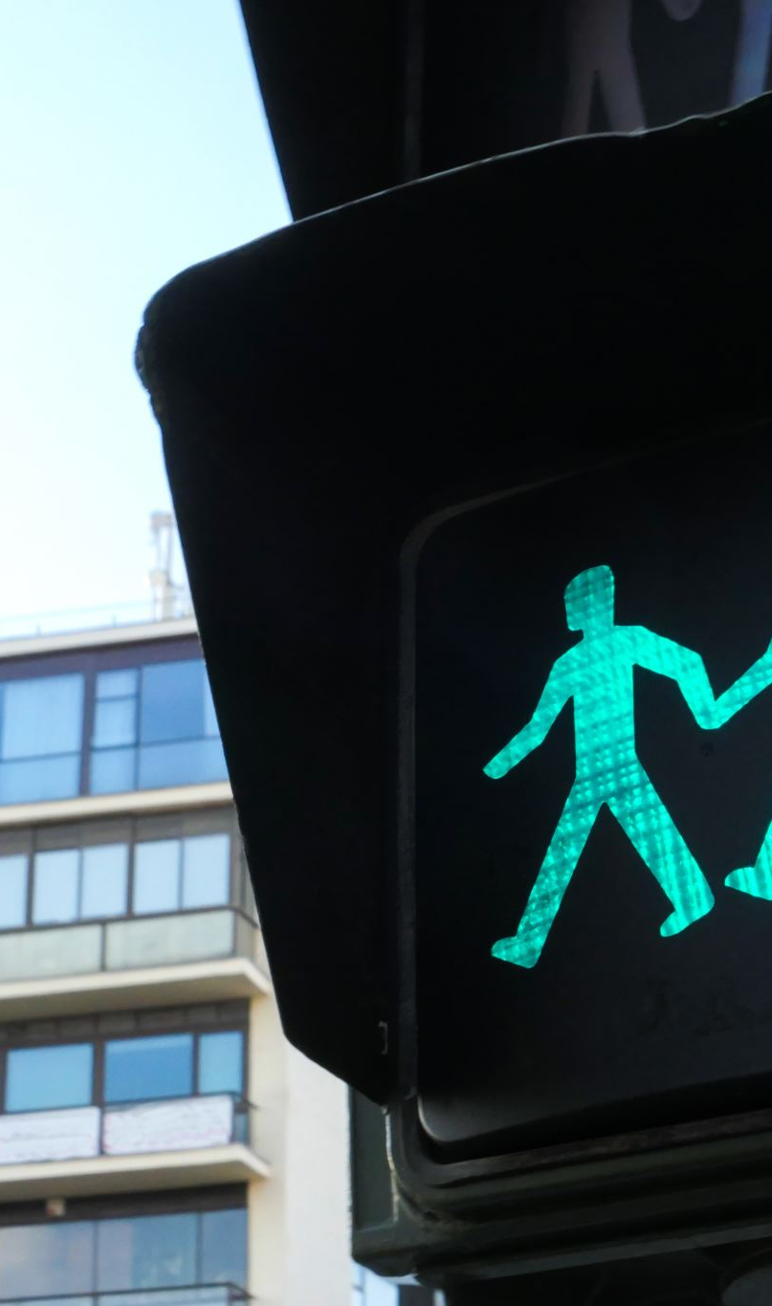
Realtime Response?
Response time for pedestrians will be lower than the standard loop time.
If there is no oncoming traffic, the pedestrian will receive the right of way.
Immediate response time to the pedestrian trying to cross when there is incoming traffic.

Slide 8
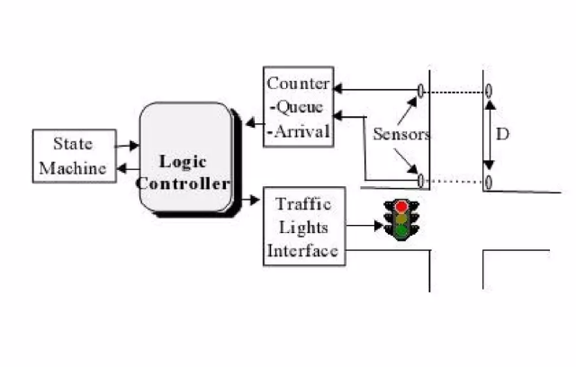
Standard System

Slide 9
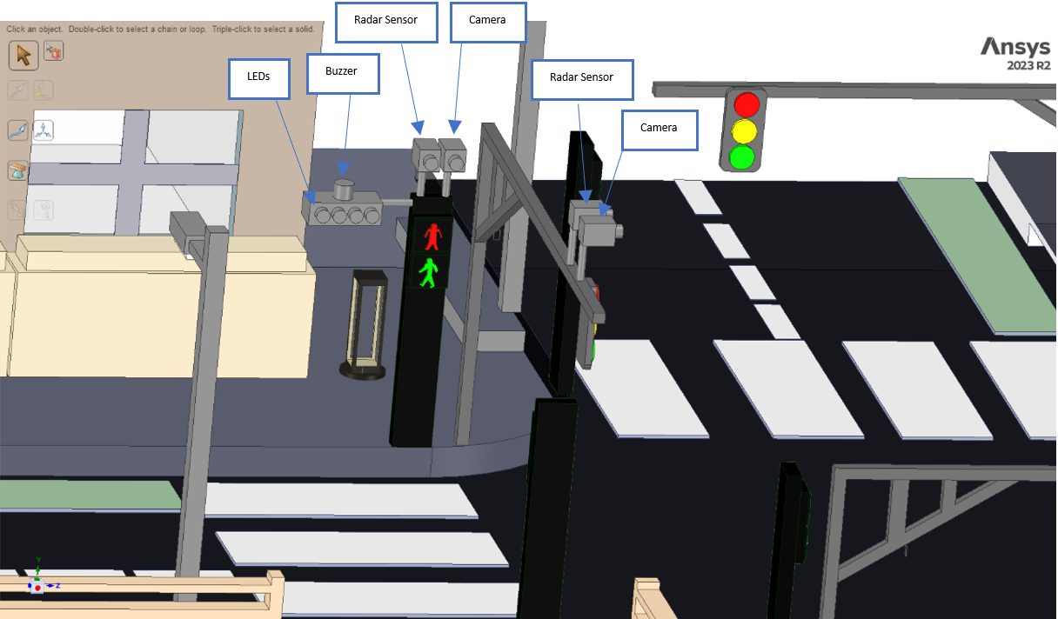
Model

Slide 10
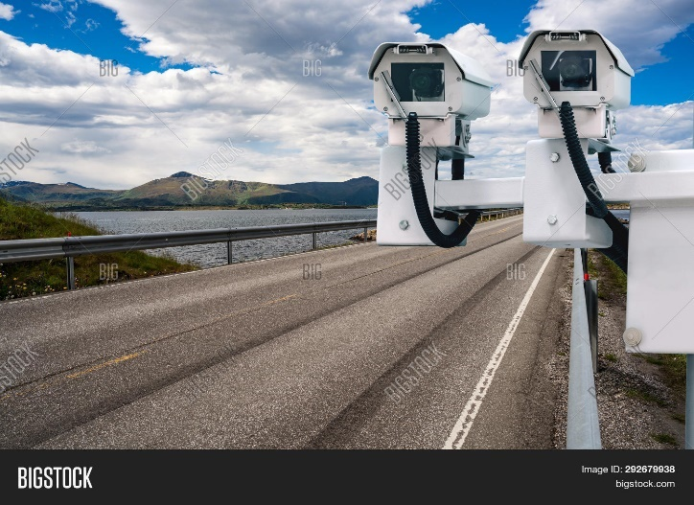

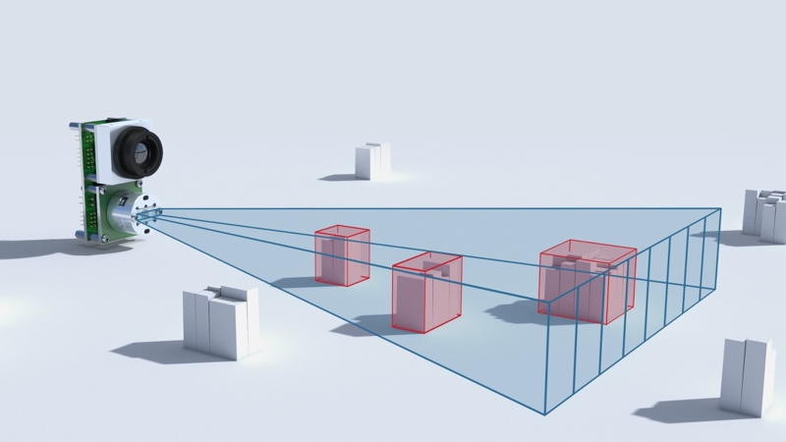

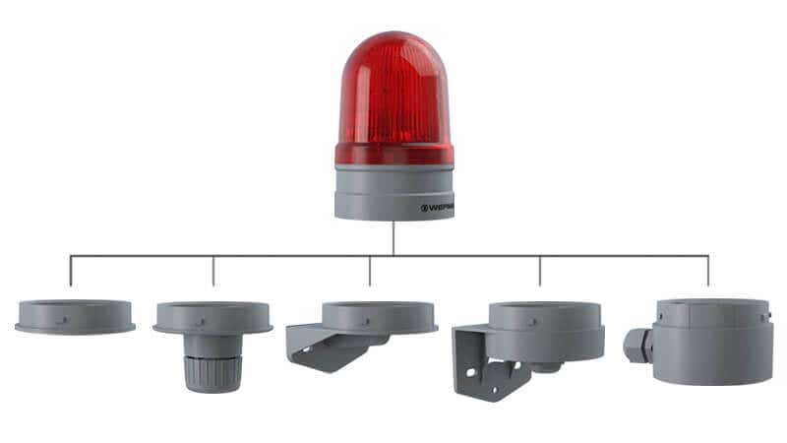
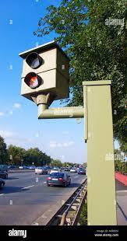
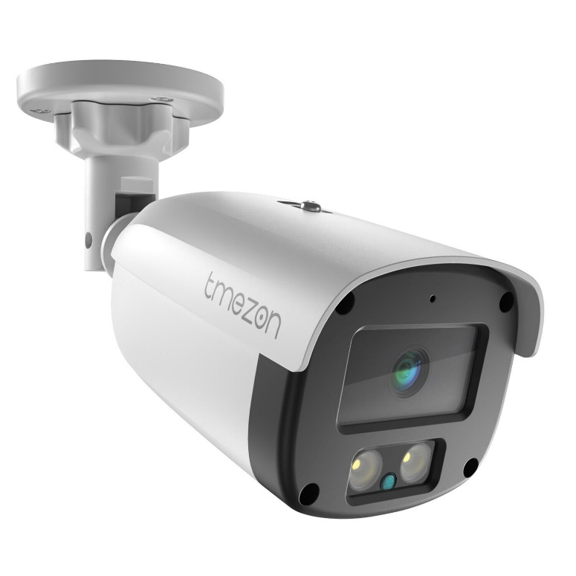

Slide 11
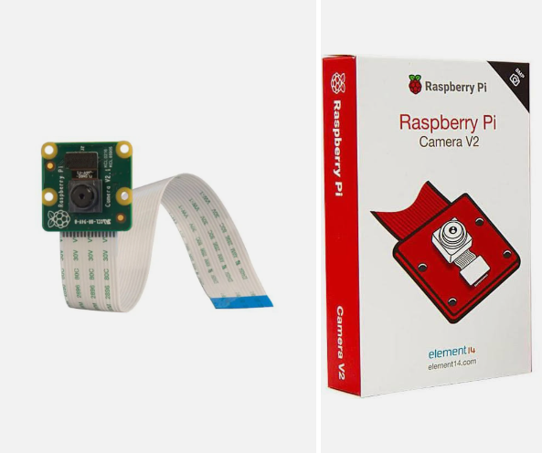

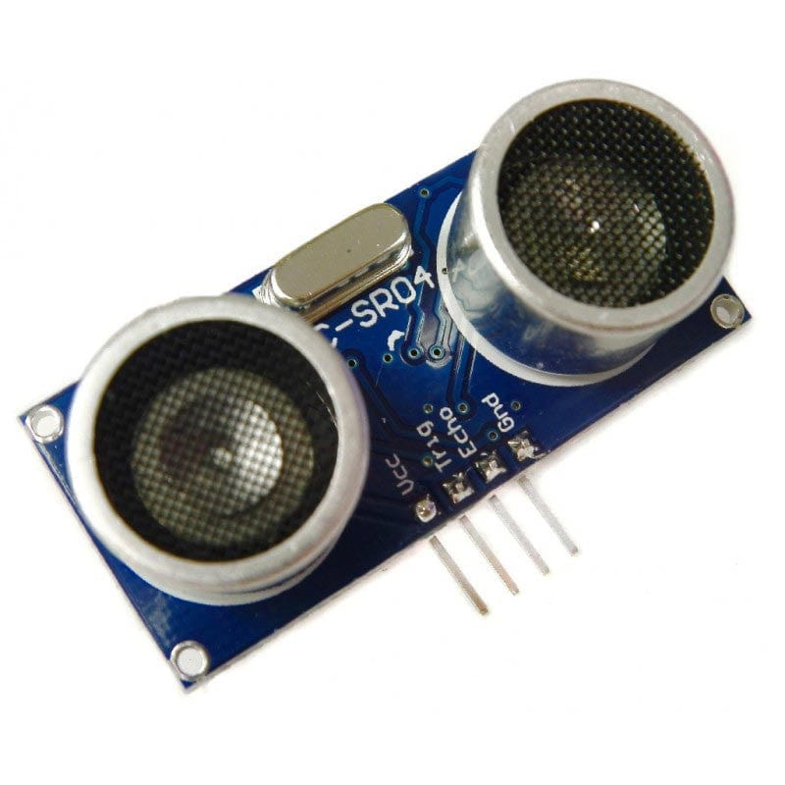
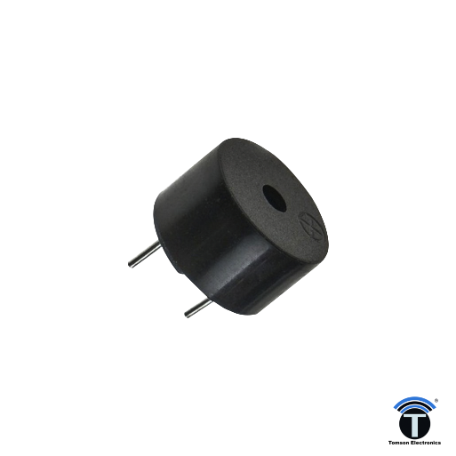

Slide 12
SW
Github
Github Management tool
CI?
DC?
Unit tests?
CV?
Deep learning?
Layers?
Design document?

Slide 13
